Slide 1
blood
indwelling
grace
submission
yielding
Freedom from spiritual bondages
through
appropriating our new nature in Christ
filling
leading
appropriating our new nature

Slide 2
Freedom from…
 Physical addictions
 Emotional disorders
 Sinful habits
 False identities & missions

Slide 3
How the problems arise…
Corrupted human nature
⇨blinded intellect & foolishness from a corrupted mind
⇨an evil & idolatrous heart
⇨defiled emotions, passions, behavior, and character
⇨an enslaved will
Choice to sin
⇨exposure to addictive substances
⇨start of habitual behaviors
⇨spiritual vulnerability
⇨exposure to demonic attack

Slide 4
The cure…
1 Peter 2.24 NET:
“He himself bore our sins in his body on the tree, that we may cease from sinning and live for righteousness. By his wounds you were healed.”
Francesco di Andrea di Marco / metmuseum.org

Slide 5
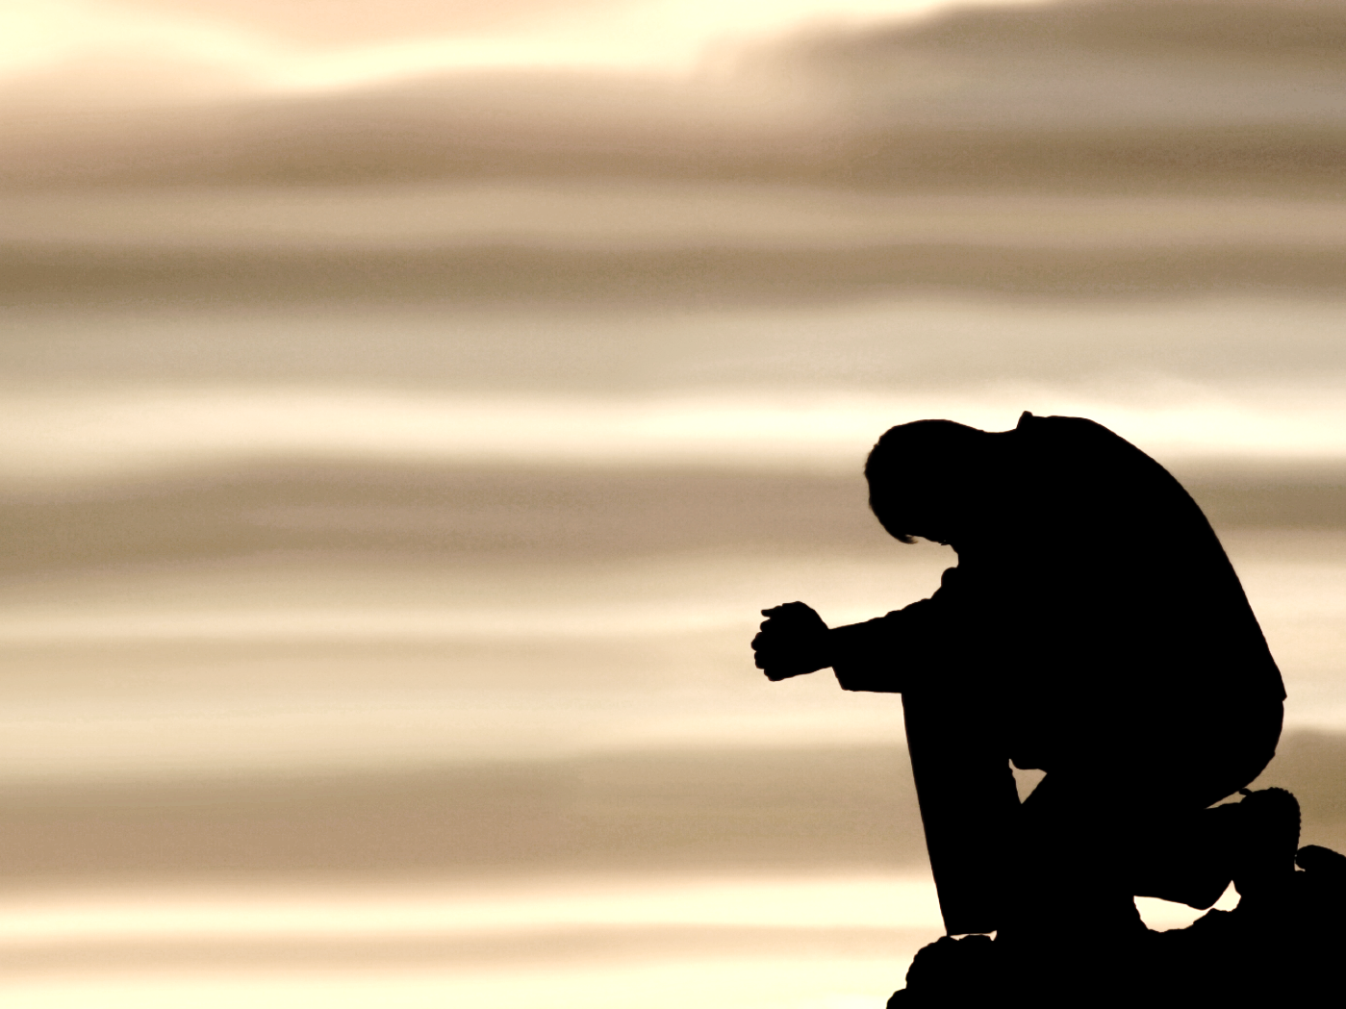
Appropriating the work of Christ…
to overcome temptation and deception

Slide 6
Appropriating the work of Christ…
to overcome temptation and deception
God is willing to forgive us:
Acts 10.43 NET: “About him [Christ] all the prophets testify, that everyone who believes
in him receives forgiveness of sins
through his name.”

Slide 7
Appropriating the work of Christ…
to overcome temptation and deception
God is willing to forgive us: Acts 10.43
God has made us spiritually alive:
Ephesians 2.4-7 NET: “But God,
being rich in mercy, because of his
great love with which he loved us,
even though we were dead in
transgressions, made us alive
together with Christ– by grace you
are saved!”

Slide 8
Appropriating the work of Christ…
to overcome temptation and deception
God is willing to forgive us: Acts 10.43
God has made us spiritually alive: Ephesians 2.4-7
God regenerated us in a new
spiritual birth:
1 Peter 1.3 NET: “Blessed be the
God and Father of our Lord
Jesus Christ! By his great mercy
he gave us new birth into a living
hope through the resurrection of
Jesus Christ from the dead.”

Slide 9
Appropriating the work of Christ…
to overcome temptation and deception
God is willing to forgive us: Acts 10.43
God has made us spiritually alive: Ephesians 2.4-7
God regenerated us in a new spiritual birth: 1 Peter 1.3
God has given us resurrected life:
Colossians 2.12 NET: “Having been
buried with him in baptism,
you also have been raised
with him through your faith in the
power of God who raised him from
the dead.”

Slide 10
Appropriating the work of Christ…
to overcome temptation and deception
God is willing to forgive us: Acts 10.43
God has made us spiritually alive: Ephesians 2.4-7
God regenerated us in a new spiritual birth: 1 Peter 1.3
God has given us resurrected life: Colossians 2.12
God has made us a new creation:
2 Corinthians 5.17 NET: “So
then, if anyone is in Christ, he is a
new creation; what is old has
passed away– look, what is new has
come!”

Slide 11
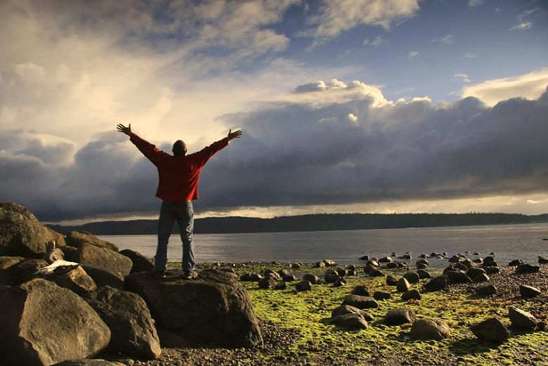
Believing the truth about yourself…
You are a “saint,” a “holy one.”
You are a brother or sister of Christ.
You are a son or daughter of God the Father.
You are a fellow heir with Christ.
You are a citizen of Heaven.
You are a child of the light.
You are part of a royal priesthood,
a holy nation, a people of God.
drewcuster.wordpress.com

Slide 12
blood
Submission to Christ, not sin…
Ephesians 4.22-24 NET: “You were taught with reference to your former way of life to lay aside the old man who is being corrupted in accordance with deceitful desires, to be renewed in the spirit of your mind, and to put on the new man who has been created in God's image– in righteousness and holiness that comes from truth.”
indwelling
grace
submission
yielding
filling
leading
appropriating our new nature

Slide 13
blood
indwelling
grace
submission
Submission to Christ, not sin…
Colossians 3.9-10 NIV: “Do not lie to each other, since you have taken off your old self with its practices and have put on the new self, which is being renewed in knowledge in the image of its Creator.”
yielding
filling
leading
appropriating our new nature

Slide 14
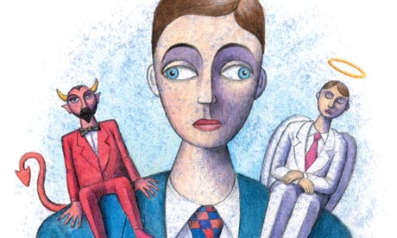
blood
theguardian.com
indwelling
grace
submission
yielding
Our Internal Struggle…
Romans 7.24-25 NET:
“Wretched man that I am! Who will rescue me from this body of death? Thanks be to God through Jesus Christ our Lord!”
filling
leading
appropriating our new nature

Slide 15
blood
We have died to sin
and been resurrected to life…
Galatians 2.20 NET:
“I have been crucified with Christ, and it is no longer I who live, but Christ lives in me. So the life I now live in the body, I live because of the faithfulness of the Son of God, who loved me and gave himself for me.”
indwelling
grace
submission
yielding
filling
leading
appropriating our new nature

Slide 16
We have died to sin and been resurrected to life…
Romans 6.3-6 NET: “Or do you not know that as many as were baptized into Christ Jesus were baptized into his death? Therefore we have been buried with him through baptism into death, in order that just as Christ was raised from the dead through the glory of the Father, so we too may live a new life. For if we have become united with him in the likeness of his death, we will certainly also be united in the likeness of his resurrection. We know that our old man was crucified with him so that the body of sin would no longer dominate us, so that we would no longer be enslaved to sin.”
appropriating our new nature

Slide 17
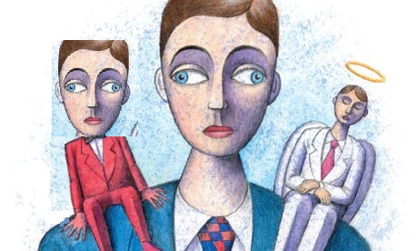
blood
indwelling
grace
submission
yielding
Our Internal Struggle…
2 Corinthians 5.14-15 NET: “For the love of Christ controls us, since we have concluded this, that Christ died for all; therefore all have died. And he died for all so that those who live should no longer live for themselves but for him who died for them and was raised.”
filling
leading
appropriating our new nature

Slide 18
blood
indwelling
grace
submission
yielding
Victory by the Spirit…
Galatians 5.24-25 NET:
“Now those who belong to Christ have crucified the flesh with its passions and desires. If we live by the Spirit, let us also behave in accordance with the Spirit.”
filling
leading
appropriating our new nature

Slide 19
blood
indwelling
grace
submission
yielding
Victory by the Spirit…
1 Corinthians 10.13 NASB: “No temptation has overtaken you but such as is common to man; and God is faithful, who will not allow you to be tempted beyond what you are able, but with the temptation will provide the way of escape also, so that you will be able to endure it.”
filling
leading
appropriating our new nature

Slide 20
Winning the battle for your mind…
Set your mind on the things of God:
Colossians 3.1-3 NET: “Therefore, if you have been raised with Christ, keep seeking the things above, where Christ is, seated at the right hand of God. Keep thinking about things above, not things on the earth, for you have died and your life is hidden with Christ in God.”

Slide 21
Winning the battle for your mind…
Set your mind on the things of God: Colossians 3.1-3
Fill your mind with the things of God:
Philippians 4.8-9 NET: “Finally, brothers and sisters, whatever is true, whatever is worthy of respect, whatever is just, whatever is pure, whatever is lovely, whatever is commendable, if something is excellent or praiseworthy, think about
these things. And what you
learned and received and
heard and saw in me, do
these things. And the God of
peace will be with you.”

Slide 22
Winning the battle for your mind…
Set your mind on the things of God: Colossians 3.1-3
Fill your mind with the things of God: Philippians 4.8-9
Take every thought captive in the name of Christ:
2 Corinthians 10.3-5 NET: “For though we live as human beings, we do not wage war according to human standards, for the weapons of our warfare are not human weapons, but are made powerful by God for tearing down strongholds. We tear down arguments and every arrogant obstacle that is raised up against the knowledge of God,
and we take every thought captive
to make it obey Christ.”

Slide 23
Winning the battle for your mind…
Set your mind on the things of God: Colossians 3.1-3
Fill your mind with the things of God: Philippians 4.8-9
Take every thought captive in the name of Christ:
2 Corinthians 10.3-5
Romans 8.1 NASB:
“Therefore there is now no
condemnation for those
who are in Christ Jesus.”

Slide 24
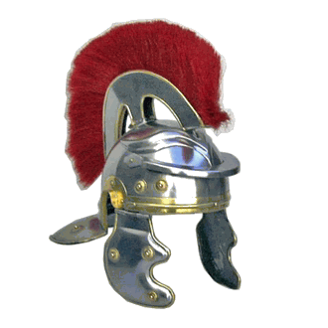
Arming ourselves against evil…
Ephesians 6.10-12 NET: “Finally, be strengthened in the Lord and in the strength of his power. Clothe yourselves with the full armor of God so that you may be able to stand against the schemes of the devil. For our struggle is not against flesh and blood, but against the rulers, against the powers, against the world rulers of this darkness, against the spiritual forces of evil in the heavens.”
historicalclothingrealm.com

Slide 25
Arming ourselves against evil…
 Absorb truth in scripture
 Know and believe the gospel
 Accept that God has granted you the righteousness of Christ
 Live out that righteousness
 Strengthen your faith in God and trust his promises
 Be diligent in prayer

Slide 26
Action steps for victory…
Get right with God!
 Commit to submit to Christ.
 Yield to, be filled by, be led by the Holy Spirit.
Learn the truth and believe it!
 Learn how God looks at you, what Christ has done for you, what you are empowered to do.
 Reflect on and memorize these truths daily.

